Slide 1

IMPACT OF CAR FEATURES
By, Pranav Jadhav
vedio link
excel sheet
pbix file
jupyter notebook

Slide 2



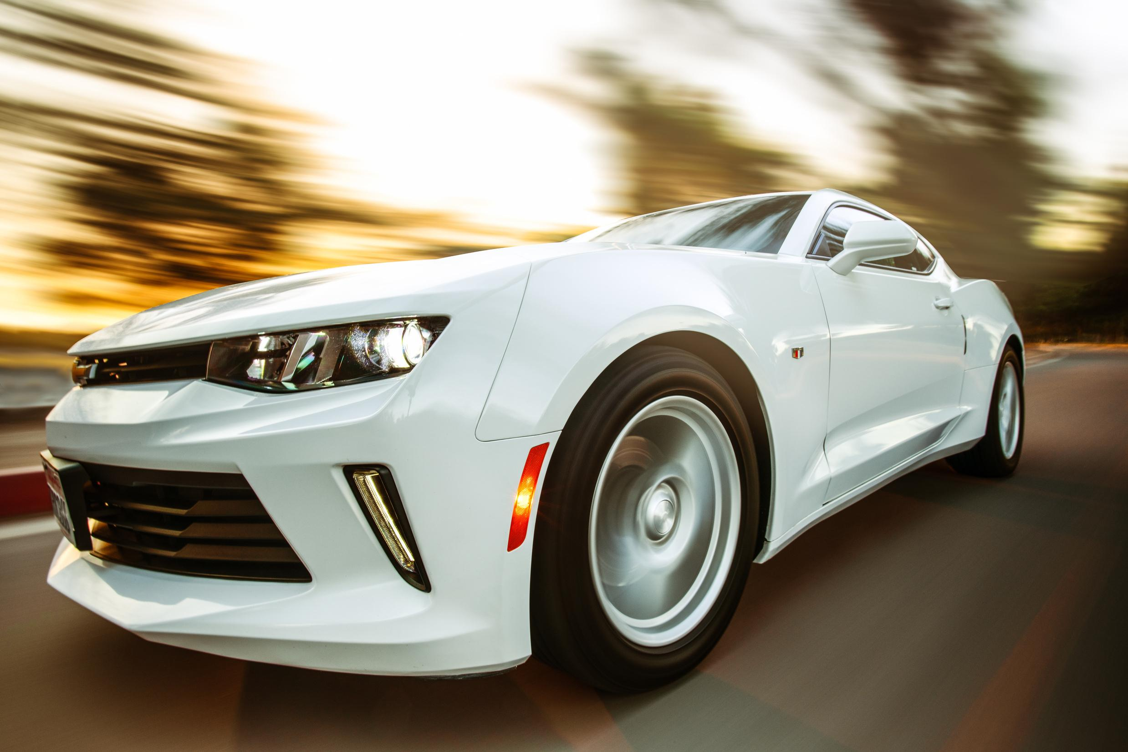
BORCELLE
Home
Service
About Us
Contact
TABLE OF CONTENT
1 | Project Description
2 | Tech Stack used
3 | Approach
4 | Analysis
5 | Insights

Slide 3

BORCELLE
Home
Service
About Us
Contact
PROJECT DESCRIPTION
Analyzing the Cars dataset to find the trends and insights which could be helpful for the Manufacturers dealers and other stake holders in order to optimize pricing and product development decisions to maximize
profitability while meeting consumer demand.

Slide 4




BORCELLE
Home
Service
About Us
Contact
TECH STACK USED
Microsoft Excel 2016
Power BI
Jupyter Notebook
canva

Slide 5
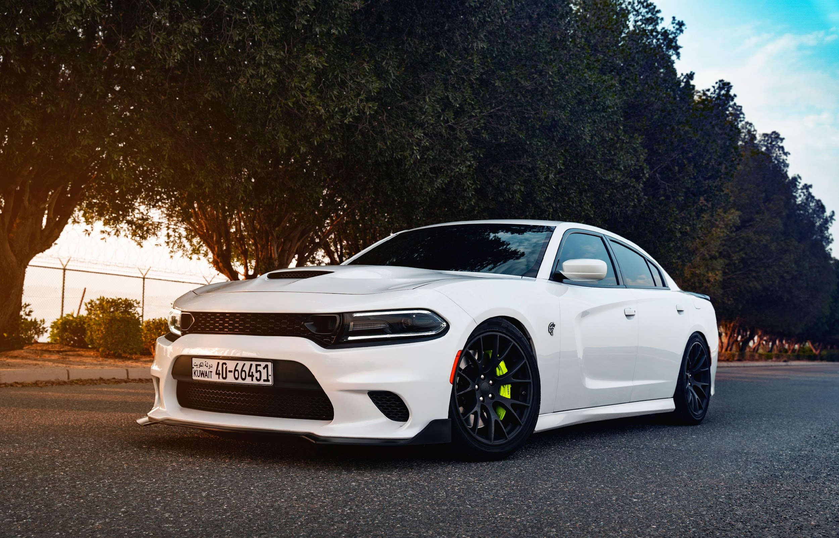
APPROACH
For this project I have used Microsoft Excel 2016, Jupyter Notebook with python and python libraries essential for data analysis and Manipulations.
The approach to this project involves Python to clean, manipulate and analyze the dataset. Coding knowledge and Algorithms were applied to handle missing data, handling outliers, create new columns, alter data based on specific criteria.
Power BI to generate visualization and dashboard to draw a meaningful insights through it.

Slide 6
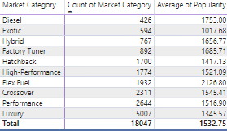
HOW DOES THE POPULARITY OF A CAR MODEL VARY ACROSS DIFFERENT MARKET CATEGORIES?

Slide 7
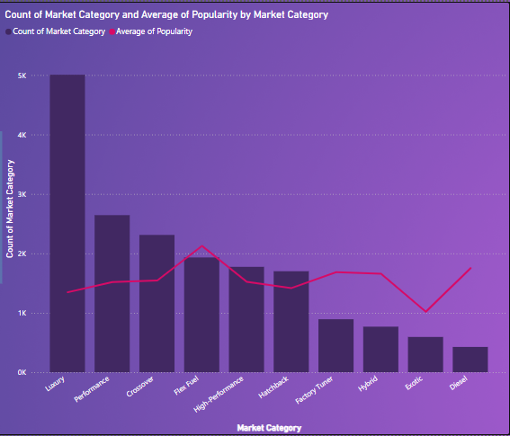
HOW DOES THE POPULARITY OF A CAR MODEL VARY ACROSS DIFFERENT MARKET CATEGORIES?
We have highest count of cars in Luxury Category but most popular category is of Flex-Fuel followed by Diesel.

Slide 8
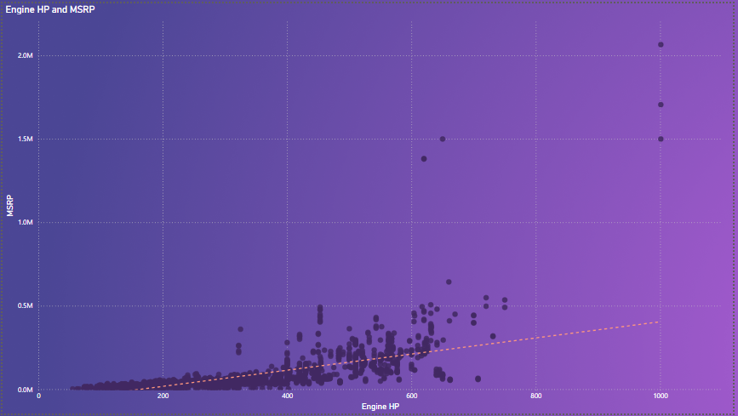
2. WHAT IS THE RELATIONSHIP BETWEEN A CAR'S ENGINE POWER AND ITS PRICE?
From the graph we can see the trend of rise in prices of cars with respect to rise in the Engine power of the car

Slide 9
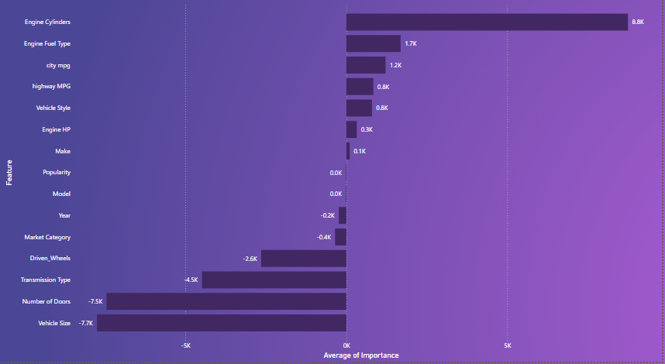
3. WHICH CAR FEATURES ARE MOST IMPORTANT IN DETERMINING A CAR'S PRICE?
Engine cylinders , number of doors , vehicle size , Engine fuel type are the some features which are most important in Determining a Car’s Price

Slide 10
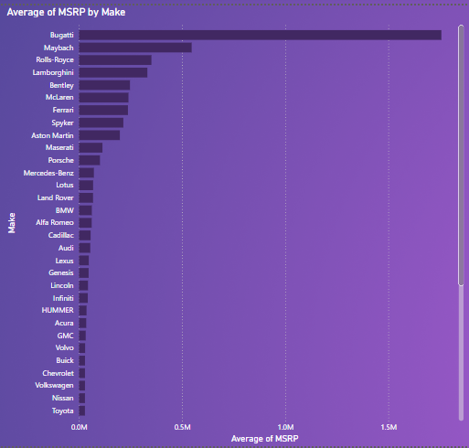
4. HOW DOES THE AVERAGE PRICE OF A CAR VARY ACROSS DIFFERENT MANUFACTURERS?
Average price for the Bugati being highest $1757223.67, followed by Maybach, Rolls-Royes and lamborgini. and lowest is Plymouth

Slide 11
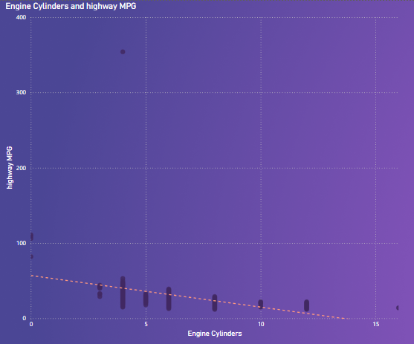
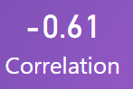
5. WHAT IS THE RELATIONSHIP BETWEEN FUEL EFFICIENCY AND THE NUMBER OF CYLINDERS IN A CAR'S ENGINE?
There is decline in the Fuel Efficiency as the number of cylinders increases.

Slide 12
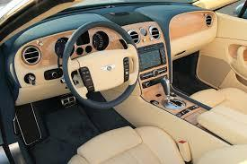
BORCELLE
Home
Service
About Us
Contact
DASHBOARD

Slide 13
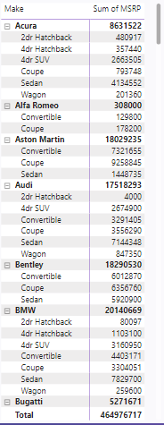
1: HOW DOES THE DISTRIBUTION OF CAR PRICES VARY BY BRAND AND BODY STYLE?

Slide 14
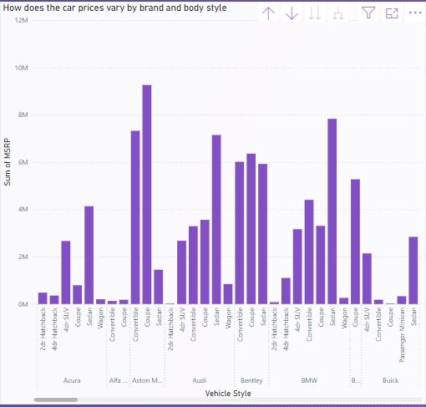
1: HOW DOES THE DISTRIBUTION OF CAR PRICES VARY BY BRAND AND BODY STYLE?

Slide 15
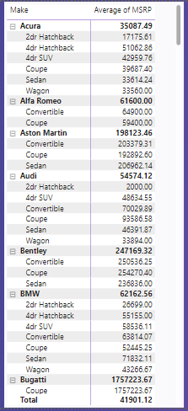
2: WHICH CAR BRANDS HAVE THE HIGHEST AND LOWEST AVERAGE MSRPS, AND HOW DOES THIS VARY BY BODY STYLE?

Slide 16
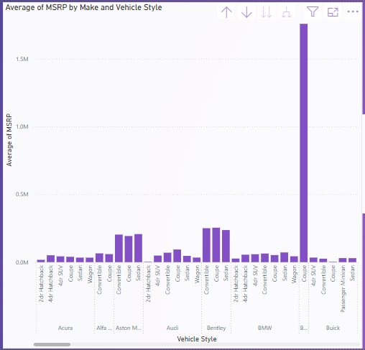
2: WHICH CAR BRANDS HAVE THE HIGHEST AND LOWEST AVERAGE MSRPS, AND HOW DOES THIS VARY BY BODY STYLE?

Slide 17
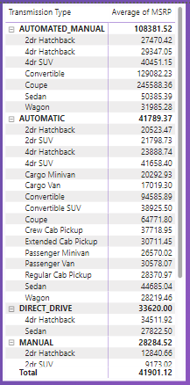
3: HOW DO THE DIFFERENT FEATURE SUCH AS TRANSMISSION TYPE AFFECT THE MSRP, AND HOW DOES THIS VARY BY BODY STYLE?

Slide 18
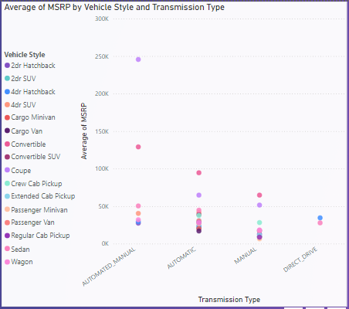
3: HOW DO THE DIFFERENT FEATURE SUCH AS TRANSMISSION TYPE AFFECT THE MSRP, AND HOW DOES THIS VARY BY BODY STYLE?

Slide 19
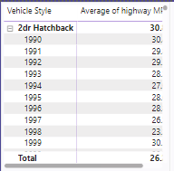
4: HOW DOES THE FUEL EFFICIENCY OF CARS VARY ACROSS DIFFERENT BODY STYLES AND MODEL YEARS?

Slide 20
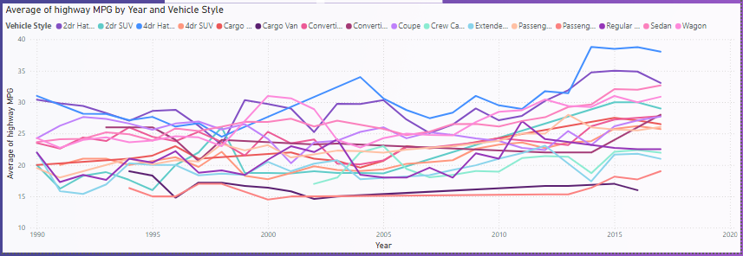
4: HOW DOES THE FUEL EFFICIENCY OF CARS VARY ACROSS DIFFERENT BODY STYLES AND MODEL YEARS?

Slide 21
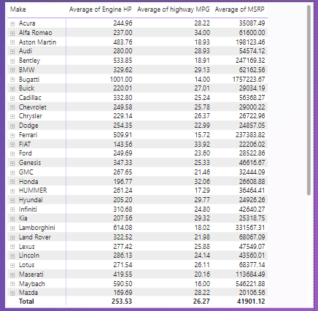
5: HOW DOES THE CAR'S HORSEPOWER, MPG, AND PRICE VARY ACROSS DIFFERENT BRANDS?

Slide 22
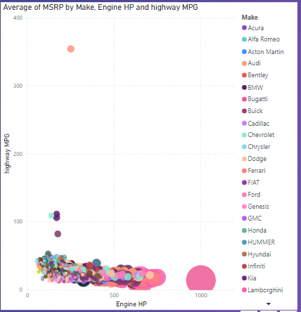
5: HOW DOES THE CAR'S HORSEPOWER, MPG, AND PRICE VARY ACROSS DIFFERENT BRANDS?

Slide 23
FINAL
DASHBOARD

Slide 24
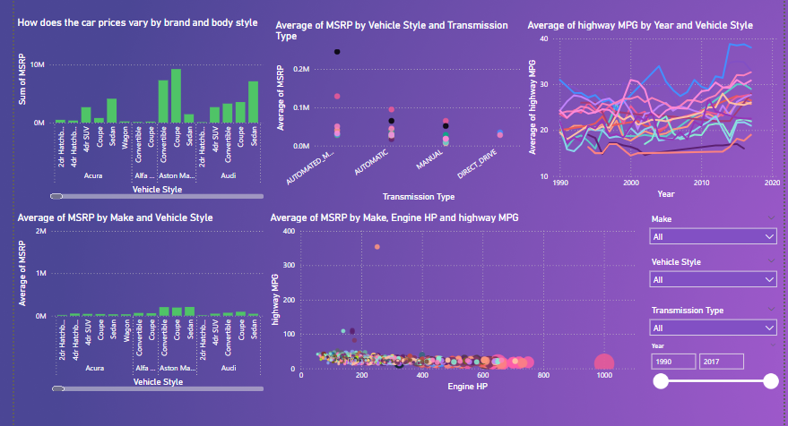

Slide 25

BORCELLE
Home
Service
About Us
Contact
CONCLUSION
In this project I have learned to apply data analytic technique in Jupyter notebook using python, and other essential Libraries like pandas, numpy , matplotlib and seaborn
Also learned to create various charts and visualizations using Power BI and represent it with the Help of Dashboard Answering the Important questions and guiding Manufacturers, dealers and statkeholders to take a rightful decisions

Slide 26
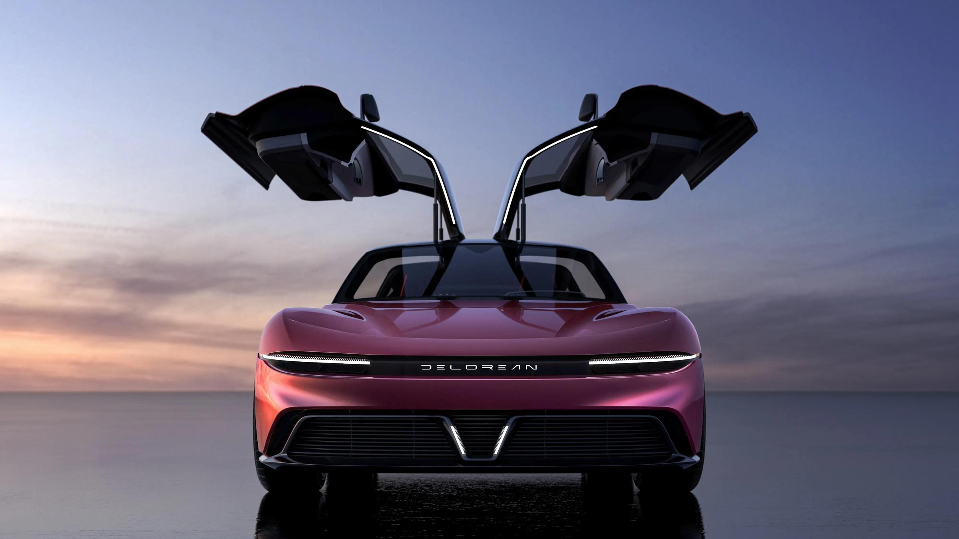
Home
Service
About Us
Contact
THANK YOU

